Slide 1

ESTRUCTURAS DE DATOS II
JONATHAN LÓPEZ LONDOÑO
JLOPEZL@UAO.EDU.CO
315 926 5443

Slide 2

Trees
Trees are a very common data structure, defined recursively as a collection of nodes.
✓ Start with a root node.
✓ Each node is a data structure containing a value, and optionally a list of references.
✓ Refer to other nodes (its children), with the limitation that there are not duplicated references, and that no one points to the root node.

Slide 3
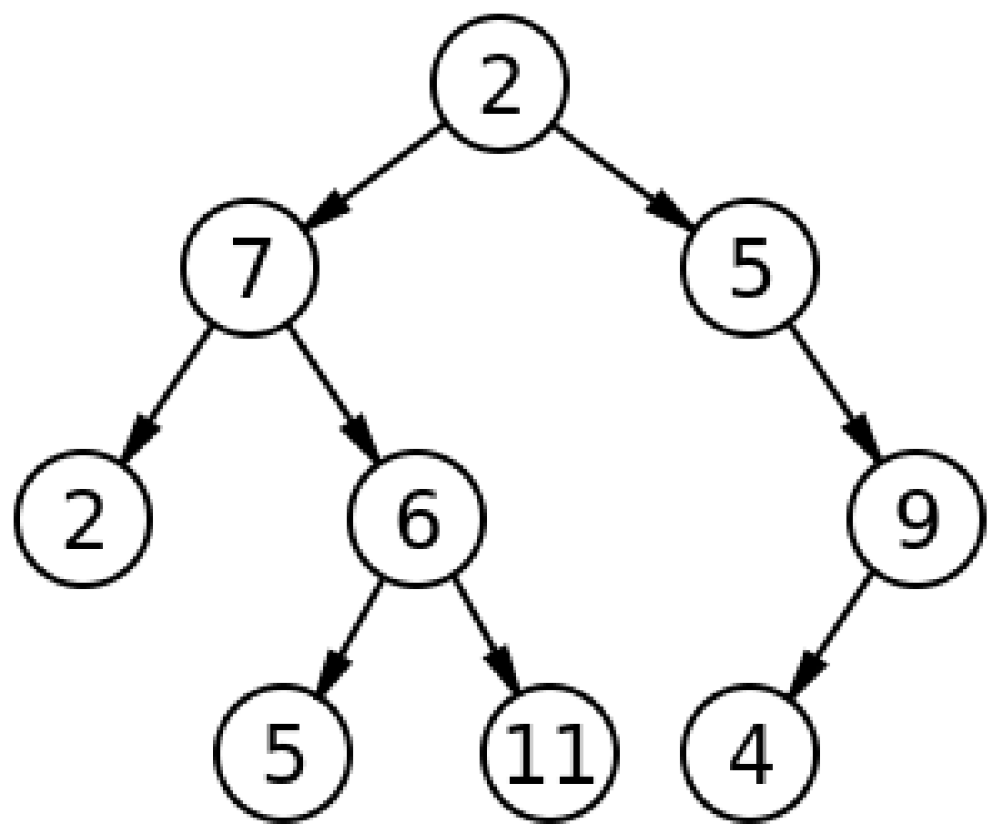
Trees
We can think of nodes that contain nodes, or trees that contain “sub-trees”.
It is common to use both words (node and tree) to refer to the same type of object but seen from two points of view.

Slide 4
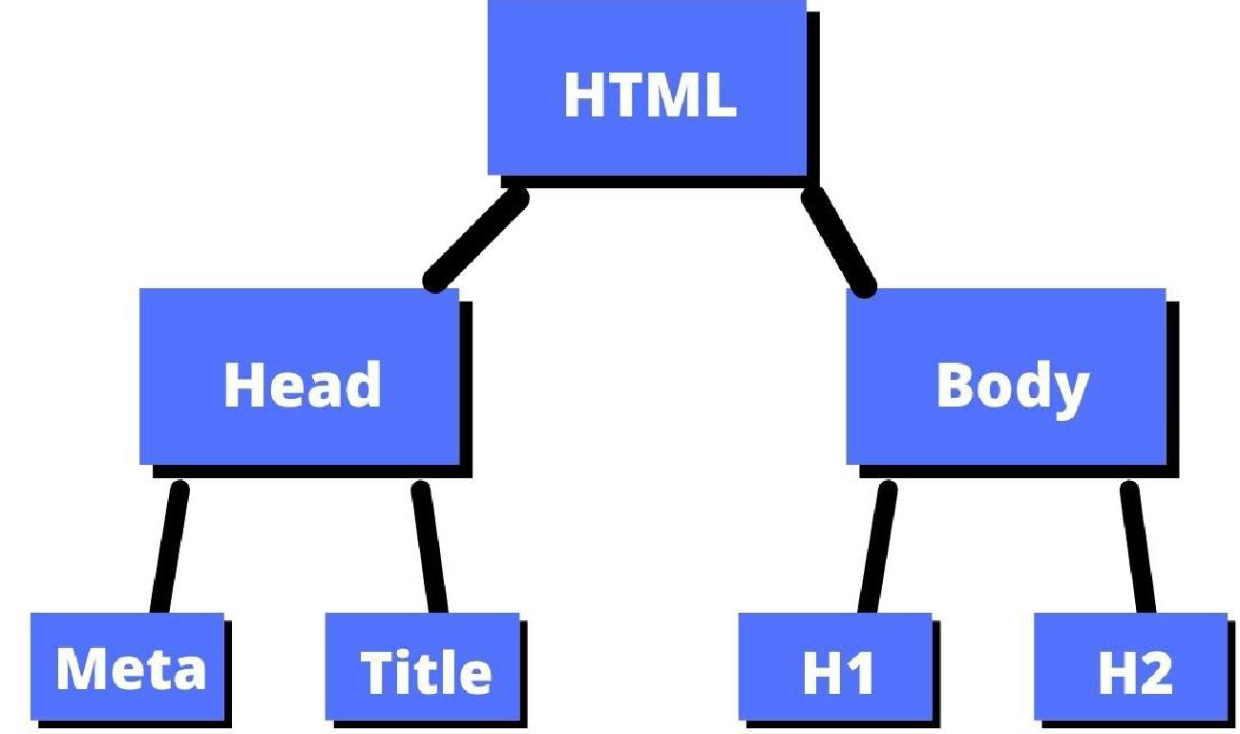
Using Trees
As a web developer, the easiest way to visualize this data structure is by imagining the DOM (Document Object Model) tree.
In this structure, we start with a root node (<html>), and each child node (DOM element) has a parent and may or may not contain one or more children.
In HTML it is natural that a node can only have one parent, since it cannot be a direct child of more than one node!

Slide 5
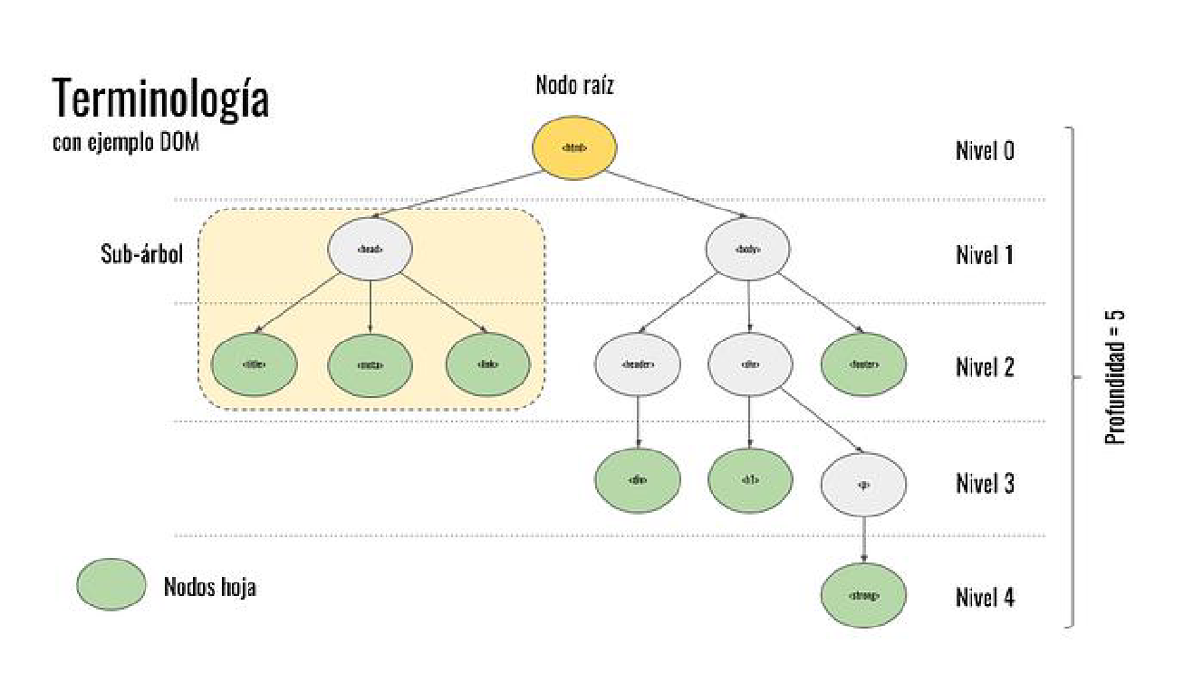
Trees Terminology
Node: is the basic structure we use to build a “tree”. All the elements of a tree are nodes.
Father / son: The "children" of a node are the nodes to which it refers. In an HTML document the <head> and <body> tags (nodes) are children of the <html> node.
Root node: Every tree has an initial root node, which will be the only node that does not have a "parent".
Leaf node: Are those that do not have children.
Level: The distance, or the number of jumps that we must take from a specific node until we reach the root node.

Slide 6
Trees Terminology
Height / depth: Refers to the maximum level that we are going to find.
Order / degree: Determines how many children a node can have. For example, a tree of order 2 would be a binary tree, where each node can have a maximum of two children. An order 3 or ternary tree would allow each node to have a maximum of three children.
Complete tree: All nodes have either no children or the maximum number of children.
Degenerate tree: When a tree contains only 1 child per node. These types of trees behave like lists.
Balanced tree: Has the minimum depth possible given several elements.

Slide 7
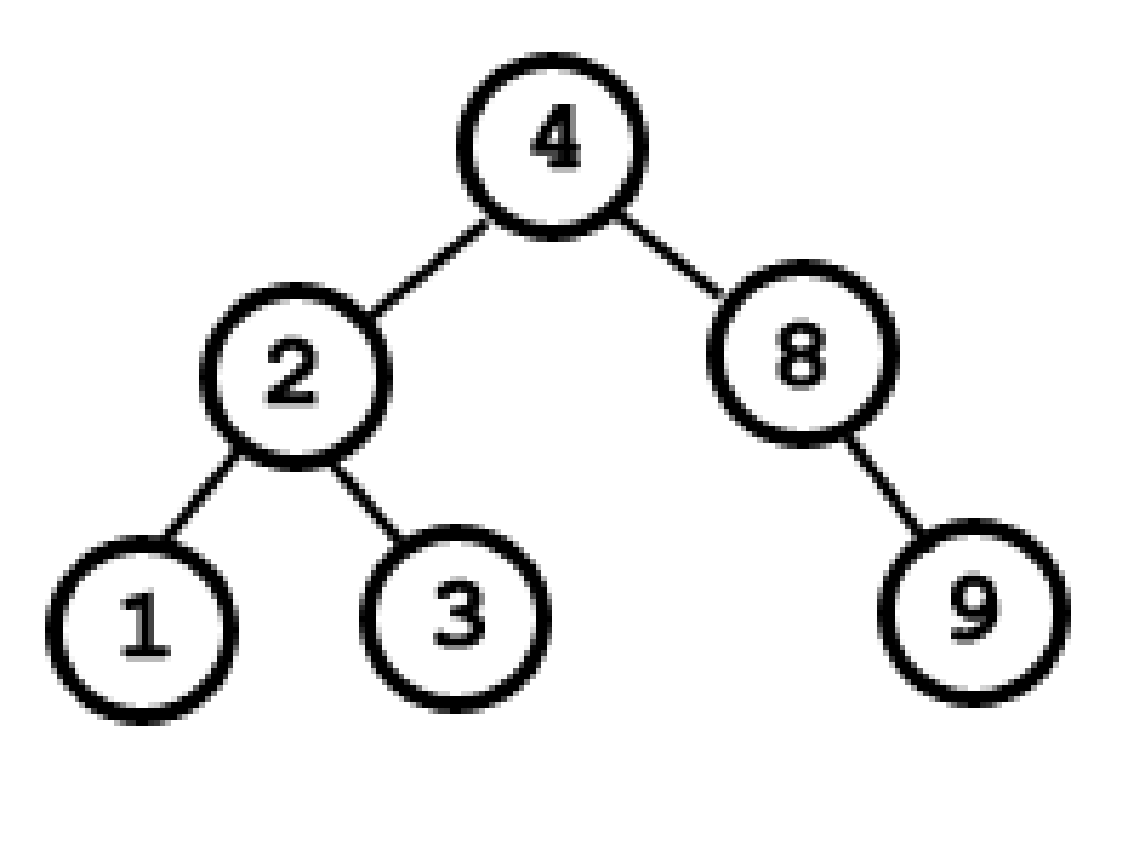
Binary Trees
Binary trees, are trees with up to two children in each node.
Left child
Right child
Starts from a root node and branches downward.

Slide 8
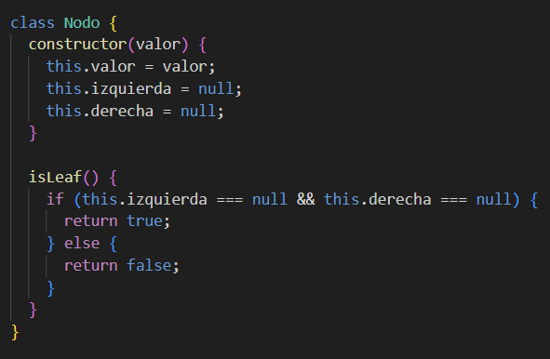
How to implement binary trees?
First, you should create a Node Class with a value and left and right references (to represent 2 children).
You can also add an isLeaf method, to check if a node is leaf or not

Slide 9
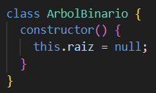
How to implement binary trees?
Second, you should create a BinaryTree Class with a root node

Slide 10
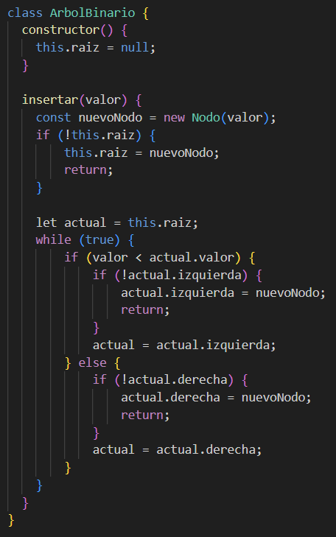
Binary Trees Methods
Insert: This method is commonly used to insert a new node according to its value, if the value is less than the parent node, the new node will be inserted at left of the parent, otherwise, it will be inserted at right of the parent.
In this example, it is considered that you can’t add a similar value to the tree.

Slide 11
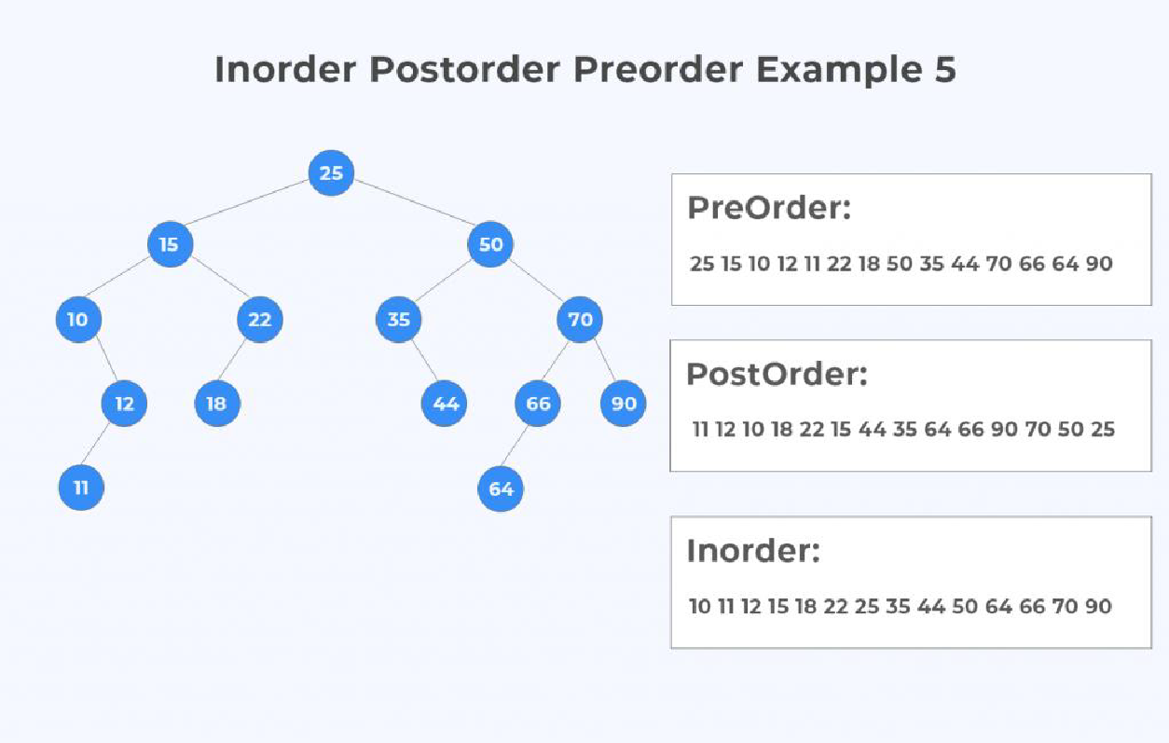
Binary Trees Methods
Printing Trees
You can print trees by 3 different ways:
PreOrder
PostOrder
InOrder
These are usually recursive methods

Slide 12
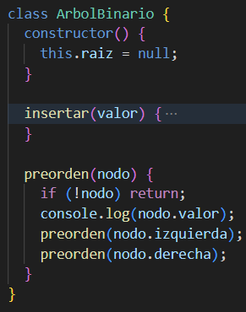
Binary Trees Methods
PreOrder: in this method you can print trees starting by the parent node, then the left child and then the right child. From top to bottom. N-L-R
InOrder: in this method you can print trees starting by the left child, then the parent node and then the right child. From bottom to top. L-N-R
PosOrder: in this method you can print trees starting by the left child, then the right child and then the parent node. From bottom to top. L-R-N

Slide 13
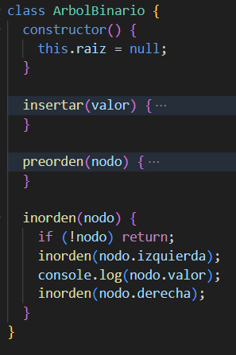
Binary Trees Methods
PreOrder: in this method you can print trees starting by the parent node, then the left child and then the right child. From top to bottom. N-L-R
InOrder: in this method you can print trees starting by the left child, then the parent node and then the right child. From bottom to top. L-N-R
PosOrder: in this method you can print trees starting by the left child, then the right child and then the parent node. From bottom to top. L-R-N

Slide 14
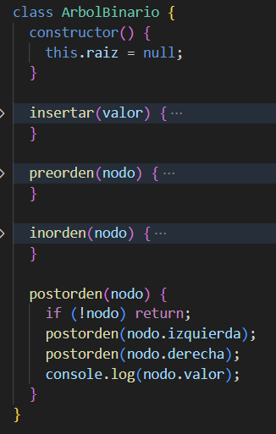
Binary Trees Methods
PreOrder: in this method you can print trees starting by the parent node, then the left child and then the right child. From top to bottom. N-L-R
InOrder: in this method you can print trees starting by the left child, then the parent node and then the right child. From bottom to top. L-N-R
PostOrder: in this method you can print trees starting by the left child, then the right child and then the parent node. From bottom to top. L-R-N

Slide 15
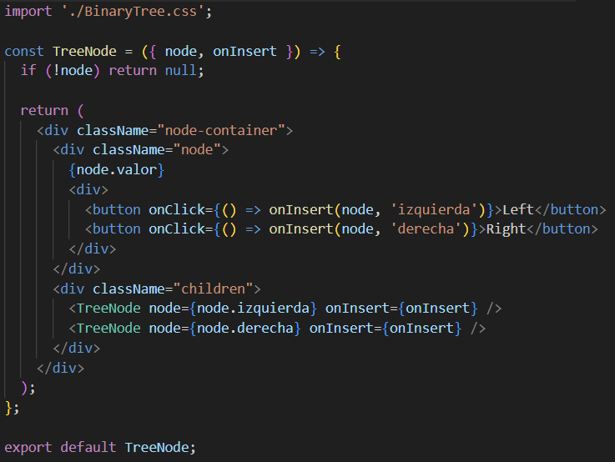
Binary Trees in React
/TeeNode.tsx

Slide 16
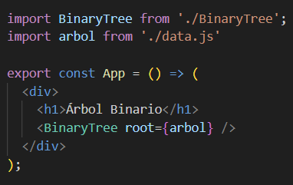
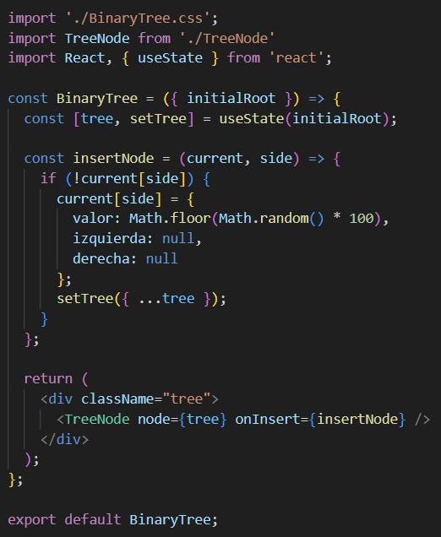
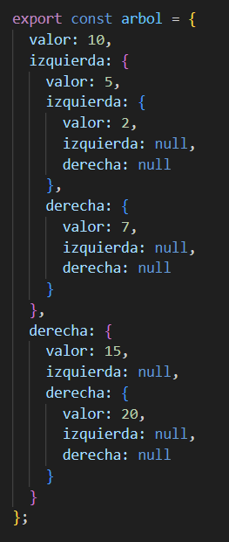
Binary Trees in React
/App.tsx
/data.js
/BinaryTree.tsx

Slide 17
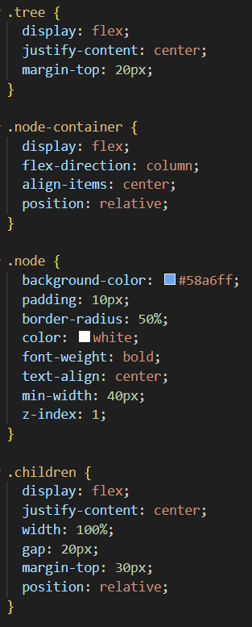
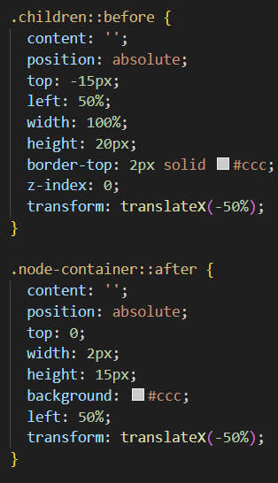
Binary Trees in React - CSS

Slide 18

CHALLENGE 08
Insert a series of numbers in a new tree and print it into inorder – postorder – preorder by console.
Write a function to check if a value is in the tree.
Install and use react-d3-tree to show the above tree, keep in mind the library’s structure.
npm install react-d3-tree
https://github.com/bkrem/react-d3-tree
Visually you can check how the tree is structured using a tool like visualgo.net

Slide 19
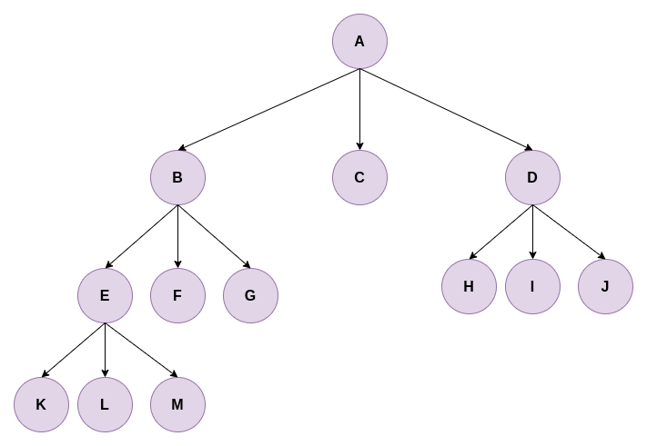
N-ary Trees
They have a root from which all nodes branch.
They are used to represent complex hierarchical structures such as:
  Operating system file tree.
  Menu or category structure.
  Family trees.
  DOM (Document Object Model) in HTML.

Slide 20
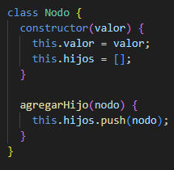
How to implement n-ary trees?
You should create a Node Class with a value and a children reference.
You can also add an addChild method, to add a node to a parent node.

Slide 21
Binary Trees Methods
Printing Trees
You can print trees by 2 different ways:
DFS (Depth-First Search)
BFS (Breadth-First Search)
These are usually recursive methods

Slide 22
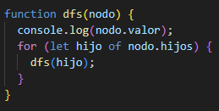
Binary Trees Methods
Printing Trees
DFS (Depth-First Search):
Print as deep into a tree as possible along a branch, before backing off and continuing with the others.

Slide 23
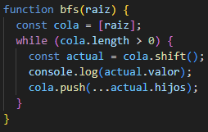
Binary Trees Methods
Printing Trees
BFS (Breadth-First Search)
Print a tree level by level, from left to right, before moving to the next level.

Slide 24
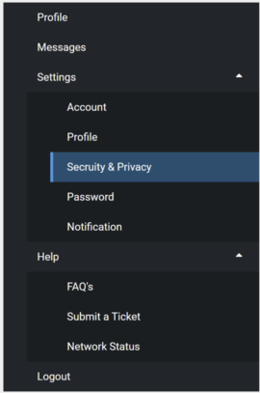
CHALLENGE 09
Create a new project in React
Fill a N-ary tree with some menus and submenus – Every Menu item will have title, a link and a component.
Create a sidebar menu in screen by printing the previous tree created.
Example:

